Slide 1
GermanTransportAnalysis (GTA)
Team Average

Slide 2

Planning
Team
1.Team member’s skills
2.Team workflow
3.Organizational tools
4.Working tools
5.Work latency
6.Team Potential

Slide 3

Planning
Requirements and plan
Sketch the plan
Formulate what we need
Formulate what to be done
Formulate how to be done
Define who is responsible for what
Target milestone
Deep context specified problem analysis(F.e :Which task has which priority level)

Slide 4
1. Team skills
Time management
Team contact
Problem solving skill
Self engagement
Helpful mind
Analytical and curious mindset
Diligent
Co-operative

Slide 5

2. Team workflow
PL
Project leading and management
Team arrangement and consultancy
APL
Directly attached to all kind of project leader’s activities
Problem solving skills
TPL
Technical and mental support to all team members
Up-to –date with latest technological changes and inform the team
DS
Data science person, responsible for data collection, analysis and refinement
Responsible person for database management as well
WD:F-END
Website developer Frontend
Responsible for Front end design and development
WD:B-End
Backend developer
Responsible for backend development and database security
S.A+ Sec
Server Administrator and also responsible for server security
IT support for server and all team members
ADeV
Android developer, responsible for android app development
Also responsible for Android app related support and also for android security
IoSDev
Ios developer (typically swift),

Slide 6
03. Organizational tools
Social media: WhatsApp group,
Video conference: Zoom, Microsoft team
Google sheets
For Version controlling: Git
Documentation: MS-Word
Project Management: Agile Method

Slide 7
4.Working tools
Possible predicted skills:
Android development
Web application development
Data mining tools(F.e Python Web scrapping,
other Data science tools like R, Hadoop)
Database management
Design (Graphics design tools)
Programming languages
Java+ Backend Libraries Python;+Frameworks+API C++, R, Git | SQL, Linux Javascript+Frameworks PHP, Wordpress

Slide 8
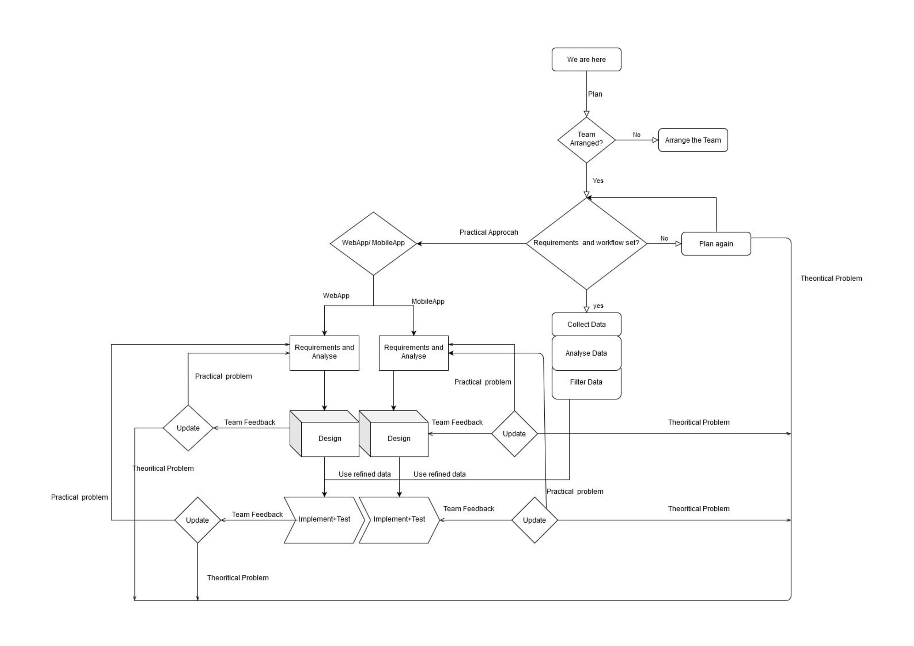
Sketch

Slide 9

THE END .. Wait for the next

